Slide 1
Memory Management:
Early Systems

Slide 2
Learning Objectives
The basic functionality of the four memory allocation schemes presented in this chapter: Single user,fixed partitions, dynamic partitions, relocatable dynamic partitions
Best-fit memory allocation as well as first-fit memory allocation schemes
How a memory list keeps track of available memory

Slide 3
Learning Objectives (continued)
The importance of deallocation of memory in a dynamic partition system
The importance of the bounds register in memory allocation schemes
The role of compaction and how it improves memory allocation efficiency

Slide 4
Introduction
Management of main memory is critical
Entire system performance dependent on two items
  How much memory is available
  Optimization of memory during job processing
This chapter introduces:
  Memory manager
  Four types of memory allocation schemes
    Single-user systems
    Fixed partitions
    Dynamic partitions
    Relocatable dynamic partitions

Slide 5
What is Memory Management?
MM is the task of storing and managing multiple processes in main memory. It is carried out by the OS, with support from the hardware.
Memory is divided into kernel space and user space, to accommodate both the kernel and user processes. MM is concerned with managing user space.

Slide 6
Single-User Contiguous Scheme
Commercially available in 1940s and 1950s
Entire program loaded into memory
Contiguous memory space allocated as needed
Jobs processed sequentially
Memory manager performs minimal work
  Register to store the base address
  Accumulator to track program size

Slide 7
Single-User Contiguous Scheme (continued)
Disadvantages
  No support for multiprogramming or networking
  Not cost effective
  Program size must be less than memory size to execute

Slide 8
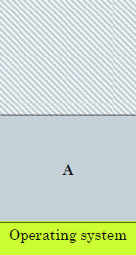
Single-User Contiguous scheme
Memory management simple
OS gets a fixed part of memory
One process executes at a time
Process is always loaded at address 0
Maximum address is total memory size (minus) OS size
Limited in capability
UNUSED SPACE
Process
Notes:
Process loaded into free space in work area

Slide 9
Fixed Partitions
Commercially available in 1950s and 1960s
Main memory is partitioned
  At system startup
  One contiguous partition per job
Permits multiprogramming
Partition sizes remain static
  Must shut down computer system to reconfigure
Requires:
  Protection of the job’s memory space
  Matching job size with partition size

Slide 10
Fixed Partitions
A program may be too big for any partition.
Internal fragmentation is significant. Unequal-sized partitions can make the problem less severe, but cannot do away with it.
Placement is trivial for fixed-size, but can be done in one of two ways for variable sizes.

Slide 11
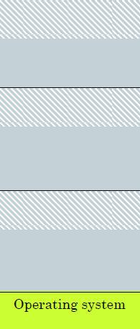
Multiple Process Memory
Divide memory into number of separate fixed areas
  OS occupies one area
Each can hold one processes
  Memory is wasted if process is smaller than partition
  Internal Fragmentation
Prevent a process being run
  If there isn't a partition big enough
UNUSED SPACE
Process A
UNUSED SPACE
Process B
UNUSED SPACE
Process C

Slide 12
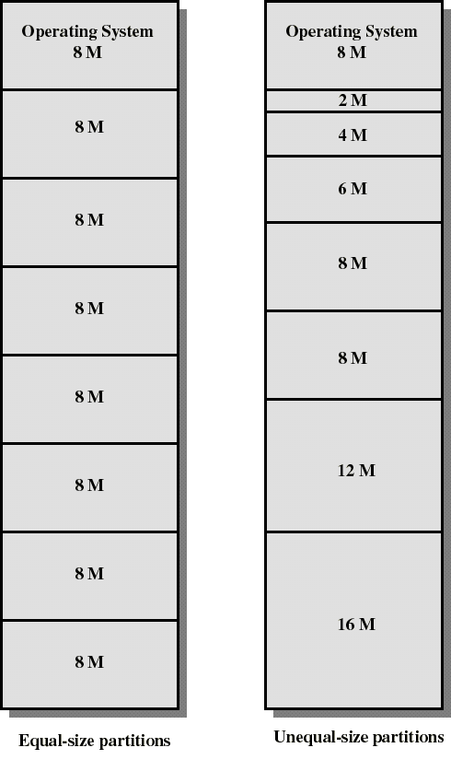
Fixed Partitioning
Partition main memory into a set of non- overlapping areas or partitions
Partitions can be of equal or unequal sizes

Slide 13
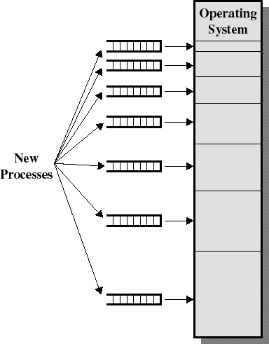
Placement Algorithm - Fixed
Multiple queues
  assigns processes to the “best fit” partition
  separate queue for each partition size
  tries to minimize internal fragmentation

Slide 14
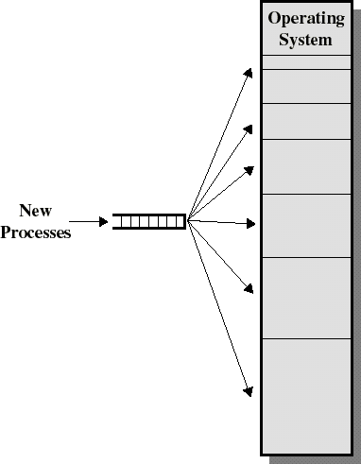
Placement Algorithm - Fixed
Single queue
  When it’s time to load a process into main memory, the smallest available partition that will hold the process is selected
  No danger that a process will wait in one queue while space is present in another

Slide 15
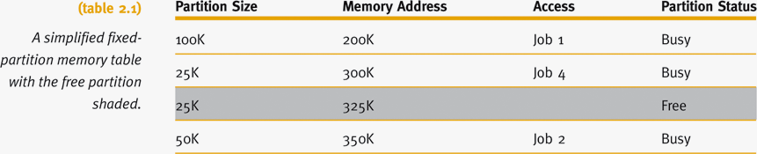
Fixed Partitions (continued)
Memory manager allocates memory space to jobs
  Uses a table

Slide 16
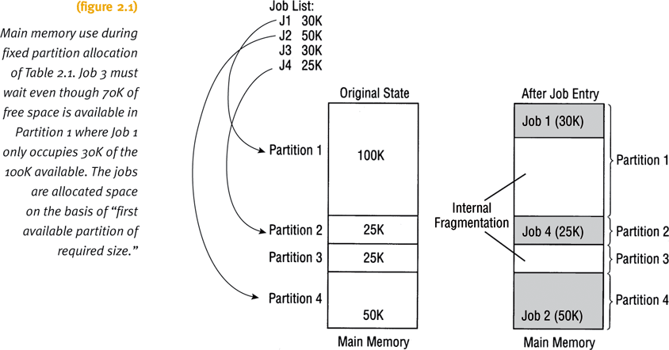
Fixed Partitions (continued)

Slide 17
Fixed Partitions (continued)
Disadvantages
  Requires contiguous loading of entire program
  Job allocation method
    First available partition with required size
  To work well:
    All jobs must be same size and memory size known ahead of time
  Arbitrary partition size leads to undesired results
    Partition too small
      Large jobs have longer turnaround time
    Partition too large
      Memory waste: internal fragmentation (fragment within a block)

Slide 18
Dynamic Partitions
Main memory is partitioned
  Jobs given memory requested when loaded
  One contiguous partition per job
Job allocation method
  First come, first serve allocation method
  Memory waste: comparatively small
Disadvantages
  Full memory utilization only during loading of initial jobs
  Subsequent allocation: memory waste
    External fragmentation: fragments between blocks

Slide 19
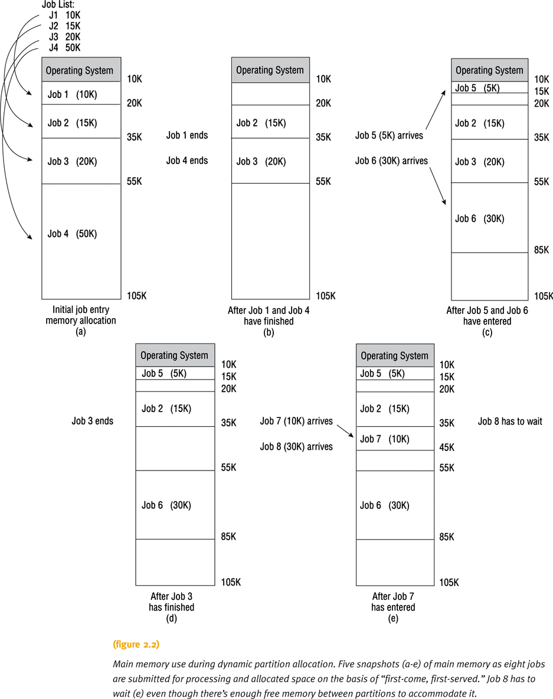

Slide 20
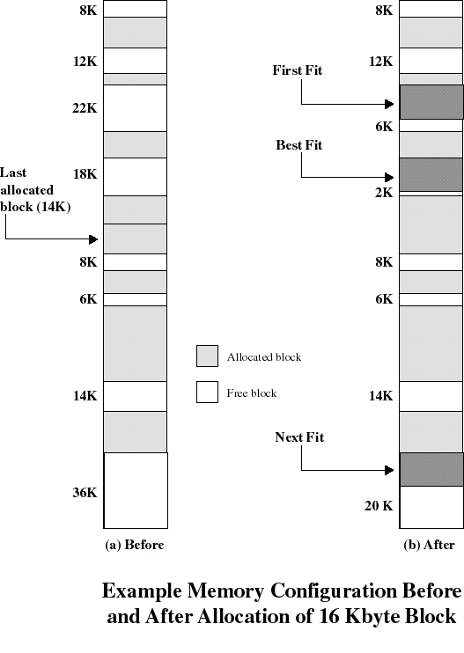
Placement Algorithms
need for compaction
Possible algorithms
  best fit: choose smallest hole
  first fit: choose first hole (that fits) from beginning
  next-fit: choose first hole from last choice
  Worst fit: opposite of best fit
Placement isn’t an issue with fixed partitions

Slide 21
Placement Algorithm: Observations
First-fit: easy, usually the fastest and best.
Next-fit: slightly worse, often leads to allocation from the largest block at the end of memory
Best-fit: usually the worst. The fragments it creates are the smallest possible, least likely to be useful. Compaction generally needs to be done more often than with other schemes.

Slide 22
Replacement Algorithms
  When all processes in main memory are blocked, the OS can swap in a suspended-ready process, if one exists.
  The OS must choose which process to replace (swap out or suspend) to make room for the incoming process.
  Considerations: state (blocked or ready), size (relative to process being swapped in), priority, ...
  Later we will discuss replacement algorithms for virtual memory management schemes.

Slide 23
Best-Fit Versus First-Fit Allocation
Two methods for free space allocation
  First-fit memory allocation: first partition fitting the requirements
    Leads to fast allocation of memory space
Keep free/busy lists organized by memory location (low order to high-order).
  Best-fit memory allocation: smallest partition fitting the requirements
    Results in least wasted space
    Internal fragmentation size reduced, but not eliminated
Fixed and dynamic memory allocation schemes use both methods

Slide 24
Best-Fit Versus First-Fit Allocation (continued)
First-fit memory allocation
  Advantage: faster in making allocation
  Disadvantage: leads to memory waste
Best-fit memory allocation
  Advantage: makes the best use of memory space
  Keep free/busy lists ordered by size (smallest to largest).
  Disadvantage: slower in making allocation

Slide 25
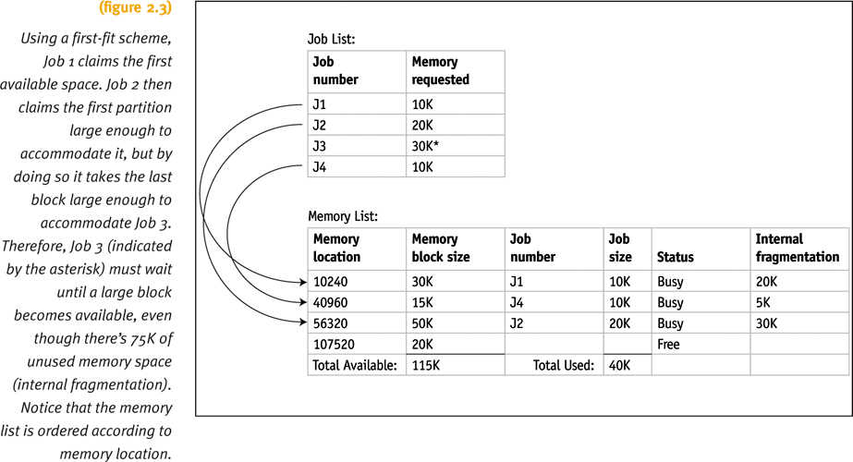
Best-Fit Versus First-Fit Allocation (continued)

Slide 26
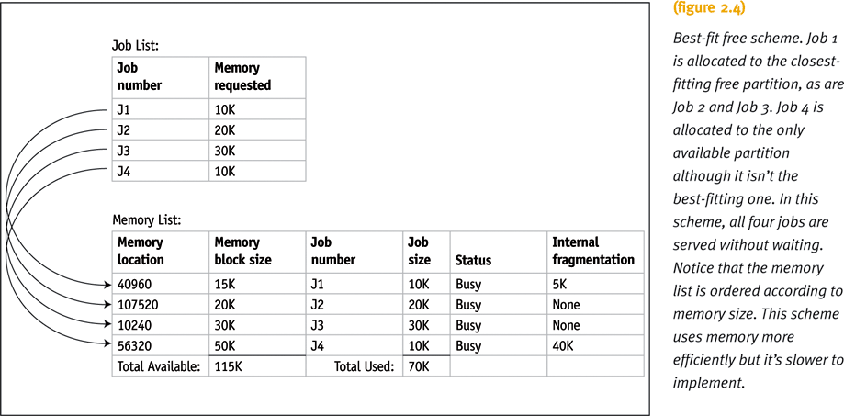
Best-Fit Versus First-Fit Allocation (continued)

Slide 27
Best-Fit Versus First-Fit Allocation (continued)
Algorithm for first-fit
  Assumes memory manager keeps two lists
    One for free memory
    One for busy memory blocks
  Loop compares the size of each job to the size of each free memory block
    Until a block is found that is large enough to fit the job
  Job stored into that block of memory
  Memory Manager moves out of the loop
    Fetches next job from the entry queue

Slide 28
Best-Fit Versus First-Fit Allocation (continued)
Algorithm for first-fit (continued):
  If entire list searched in vain
    Then job is placed into waiting queue
    Otherwise, Memory Manager fetches next job
  Process repeats

Slide 29
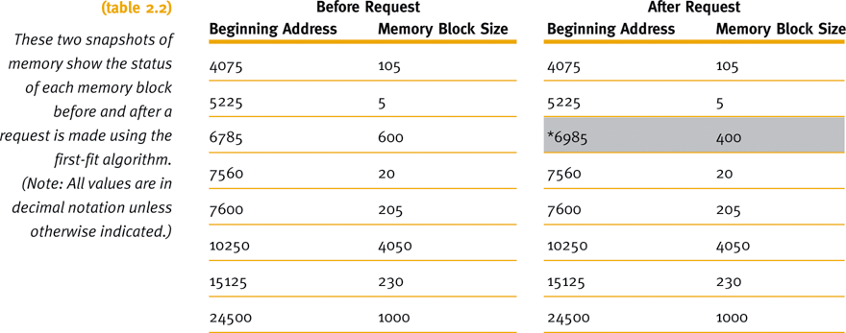
Best-Fit Versus First-Fit Allocation (continued)
First-fit: a request for a block of 200 spaces.

Slide 30
Best-Fit Versus First-Fit Allocation (continued)
Algorithm for best-fit
  Goal
    Find the smallest memory block into which the job will fit
  Entire table searched before allocation

Slide 31
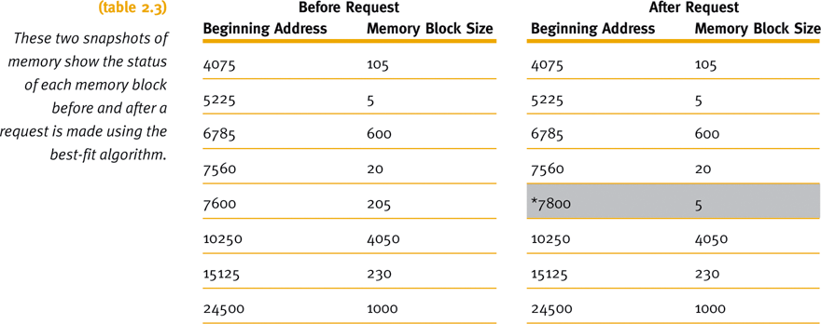
Best-Fit Versus First-Fit Allocation (continued)
Best-fit: a request for a block of 200 spaces.

Slide 32
Best-Fit Versus First-Fit Allocation (continued)
Hypothetical allocation schemes
  Next-fit: starts searching from last allocated block, for next available block when a new job arrives
  Worst-fit: allocates largest free available block to new job
    Opposite of best-fit
    Good way to explore theory of memory allocation
    Not best choice for an actual system

Slide 33
Deallocation
Deallocation: freeing allocated memory space
For fixed-partition system:
  Straightforward process
  Memory Manager resets the status of job’s memory block to “free” upon job completion
  Any code may be used
  Example code: binary values with zero indicating free and one indicating busy

Slide 34
Deallocation (continued)
For dynamic-partition system:
  Algorithm tries to combine free areas of memory
  More complex
Three dynamic partition system cases
  Case 1: When the block to be deallocated is adjacent to another free block
  Case 2: When the block to be deallocated is between two free blocks
  Case 3: When the block to be deallocated is isolated from other free blocks

Slide 35
Case 1: Joining Two Free Blocks
Blocks are adjacent
List changes to reflect starting address of the new free block
  Example: 7600 - the address of the first instruction of the job that just released this block
Memory block size changes to show its new size for the new free space
  Combined total of the two free partitions
  Example: (200 + 5)

Slide 36
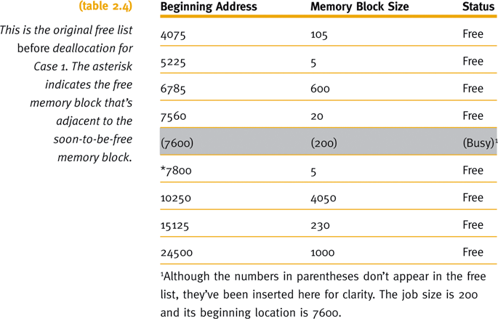
Case 1: Joining Two Free Blocks (continued)

Slide 37
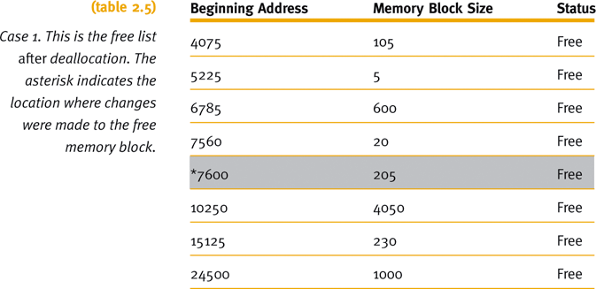
Case 1: Joining Two Free Blocks (continued)

Slide 38
Case 2: Joining Three Free Blocks
Deallocated memory space
  Between two free memory blocks
List changes to reflect starting address of new free block
  Example: 7560 was smallest beginning address
Sizes of the three free partitions must be combined
  Example: (20 + 20 + 205)
Combined entry (last of the three) given status of “null”
  Example: 7600

Slide 39
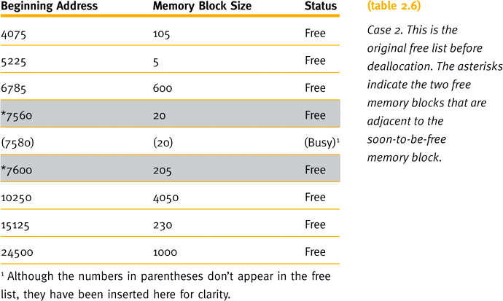
Case 2: Joining Three Free Blocks (continued)

Slide 40
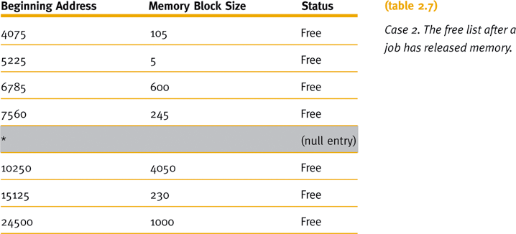
Case 2: Joining Three Free Blocks (continued)

Slide 41
Case 3: Deallocating an Isolated Block
Deallocated memory space
  Isolated from other free areas
System determines released memory block status
  Not adjacent to any free blocks of memory
  Between two other busy areas
System searches table for a null entry
  Occurs when memory block between two other busy memory blocks is returned to the free list

Slide 42
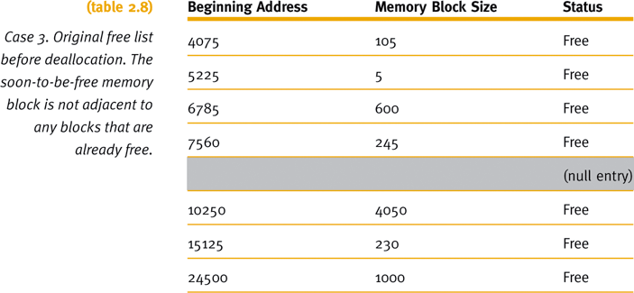
Case 3: Deallocating an Isolated Block (continued)

Slide 43
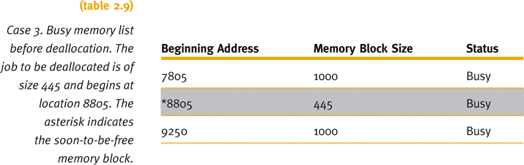
Case 3: Deallocating an Isolated Block (continued)

Slide 44
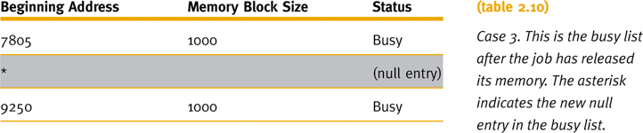
Case 3: Deallocating an Isolated Block (continued)

Slide 45
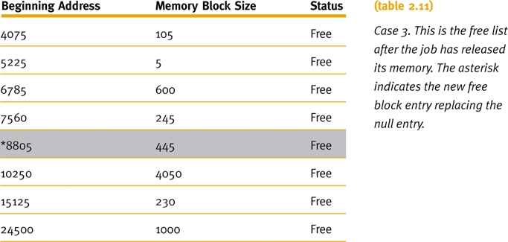
Case 3: Deallocating an Isolated Block (continued)
Compare to Table 2.8

Slide 46
Relocatable Dynamic Partitions
Memory Manager relocates programs
  Gathers together all empty blocks
Compact the empty blocks
  Make one block of memory large enough to accommodate some or all of the jobs waiting to get in

Slide 47
Relocatable Dynamic Partitions
(continued)
Compaction: reclaiming fragmented sections of memory space
  Every program in memory must be relocated
    Programs become contiguous
  Operating system must distinguish between addresses and data values
    Every address adjusted to account for the program’s new location in memory
    Data values left alone

Slide 48
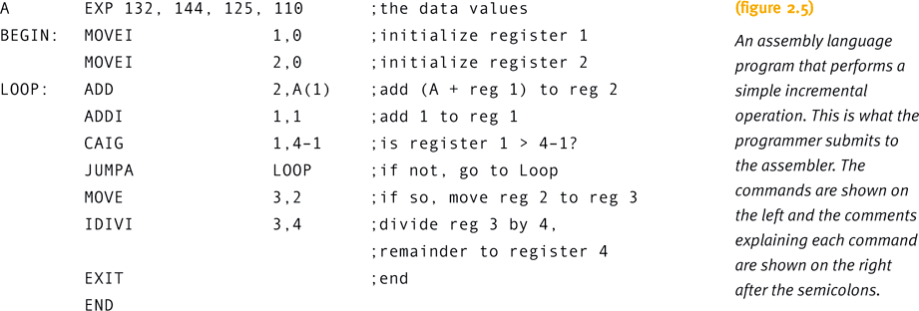
Relocatable Dynamic Partitions
(continued)

Slide 49
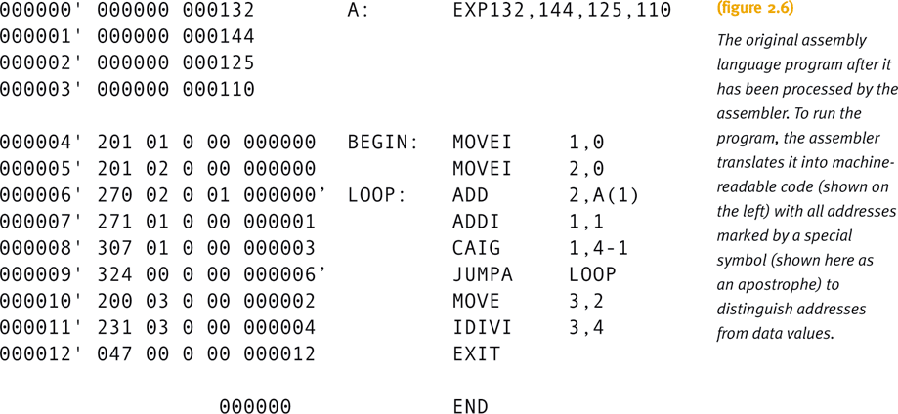
Relocatable Dynamic Partitions
(continued)

Slide 50
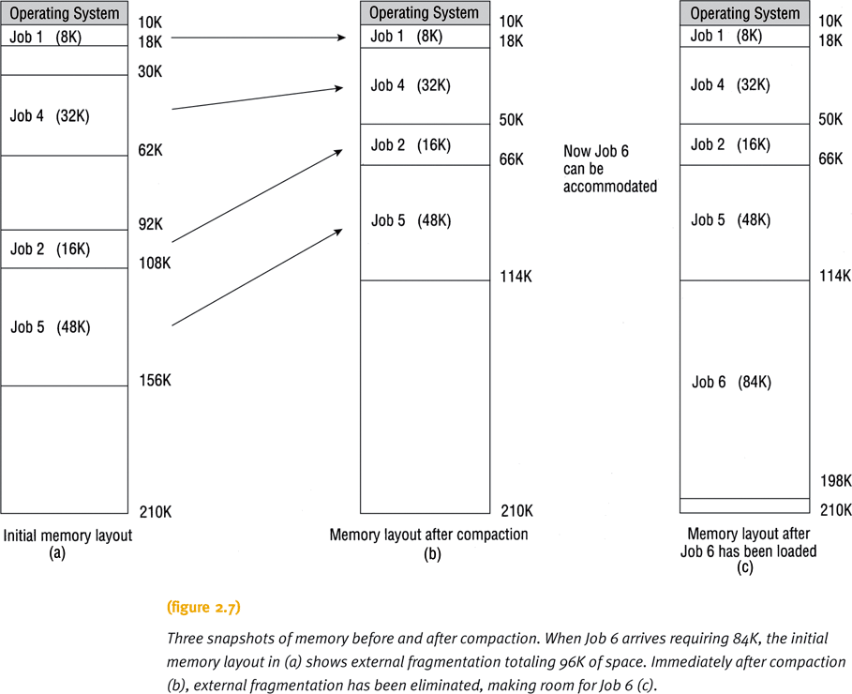

Slide 51
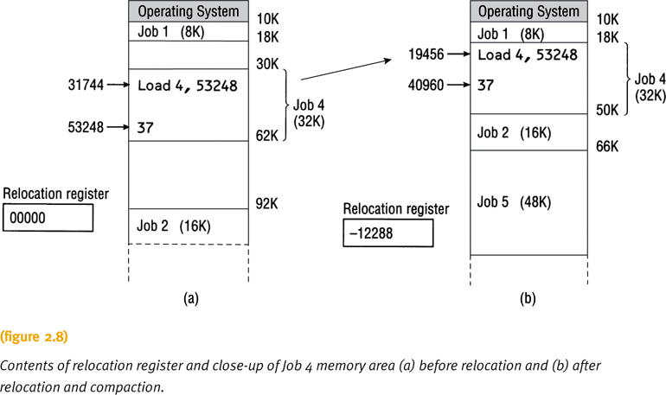

Slide 52
Relocatable Dynamic Partitions
(continued)
Compaction issues:
  What goes on behind the scenes when relocation and compaction take place?
  What keeps track of how far each job has moved from its original storage area?
  What lists have to be updated?

Slide 53
Relocatable Dynamic Partitions
(continued)
What lists have to be updated?
  Free list
    Must show the partition for the new block of free memory
  Busy list
    Must show the new locations for all of the jobs already in process that were relocated
  Each job will have a new address
    Exception: those already at the lowest memory locations

Slide 54
Relocatable Dynamic Partitions
(continued)
Special-purpose registers used for relocation:
  Bounds register
    Stores highest location accessible by each program
  Relocation register
    Contains the value that must be added to each address referenced in the program
    Must be able to access the correct memory addresses after relocation
    If the program is not relocated, “zero” value stored in the program’s relocation register

Slide 55
Relocatable Dynamic Partitions
(continued)
Compacting and relocating optimizes use of memory
  Improves throughput
Options for timing of compaction:
  When a certain percentage of memory is busy
  When there are jobs waiting to get in
  After a prescribed amount of time has elapsed
Compaction entails more overhead
Goal: optimize processing time and memory use while keeping overhead as low as possible

Slide 56
Summary
Four memory management techniques
  Single-user systems, fixed partitions, dynamic partitions, and relocatable dynamic partitions
Common requirements of four memory management techniques
  Entire program loaded into memory
  Contiguous storage
  Memory residency until job completed
Each places severe restrictions on job size
Sufficient for first three generations of computers

Slide 57
Summary (continued)
New modern memory management trends in late 1960s and early 1970s
  Discussed in next chapter
  Common characteristics of memory schemes
    Programs are not stored in contiguous memory locations
    Not all segments reside in memory during execution of job

Slide 58
Memory Management:
Virtual Memory

Slide 59
Learning Objectives
The basic functionality of the memory allocation methods covered in this chapter: paged, demand paging, segmented, and segmented/demand paged memory allocation
The influence that these page allocation methods have had on virtual memory
The difference between a first-in first-out page replacement policy, a least-recently-used page replacement policy, and a clock page replacement policy

Slide 60
Learning Objectives (continued)
The mechanics of paging and how a memory allocation scheme determines which pages should be swapped out of memory
The concept of the working set and how it is used in memory allocation schemes
The impact that virtual memory had on multiprogramming
Cache memory and its role in improving system response time

Slide 61
Introduction
Evolution of virtual memory
  Paged, demand paging, segmented, segmented/demand paging
  Foundation for current virtual memory methods
Improvement from early schemes:
  Need for continuous program storage
  Need for placement of entire program in memory during execution
  Fragmentation
  Overhead due to relocation

Slide 62
Introduction (continued)
Page replacement policies
  First-In First-Out
  Least Recently Used
  Most-Frequently used
  Clock replacement and bit-shifting
  Mechanics of paging
  The working set
Virtual memory
  Concepts and advantages
Cache memory
  Concepts and advantages

Slide 63
Paged Memory Allocation
Divides each incoming job into pages of equal size
Best condition
  Page size = Memory block (page frame) size = Size of disk section (sector)
    Sizes depend on operating system and disk sector size
Memory manager tasks prior to program execution
  Determines number of pages in program
  Locates enough empty page frames in main memory
  Loads all program pages into page frames
Advantage of storing program non-contiguously
  New problem: keeping track of job’s pages

Slide 64

Disk Structure

Slide 65
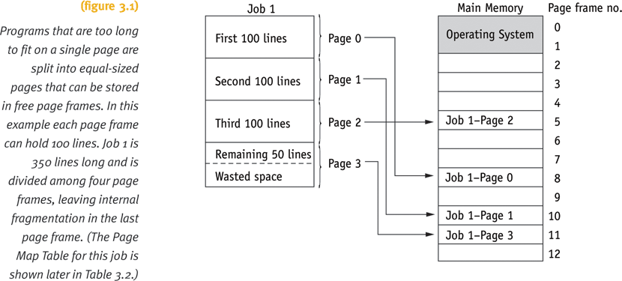
Paged Memory Allocation (continued)
Job Table
Page Map Table
Memory Map Table

Slide 66
Paged Memory Allocation (continued)
Three tables for tracking pages
  Job Table (JT) contains
    Size of each active job and
    Memory location where its PMT is stored
    One JT for the whole system
  Page Map Table (PMT) contains
    Page number and
    Its corresponding page frame address
    One PMT for each job
  Memory Map Table (MMT) contains
    Location for each page frame and
    Free/busy status
    One MMT for the whole system

Slide 67
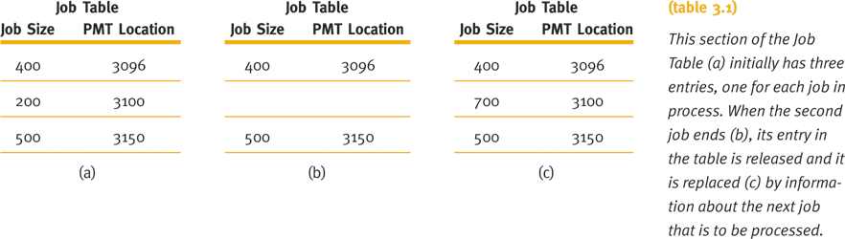
Paged Memory Allocation (continued)

Slide 68
Paged Memory Allocation (continued)
Displacement (offset) of a line (statement)
  To determine line distance from beginning of its page
  Used to locate line within its page frame
  A relative value
Determining page number and displacement of a line
  Divide job space address by the page size
  Page number: integer quotient from the division
  Displacement: remainder from the division

Slide 69
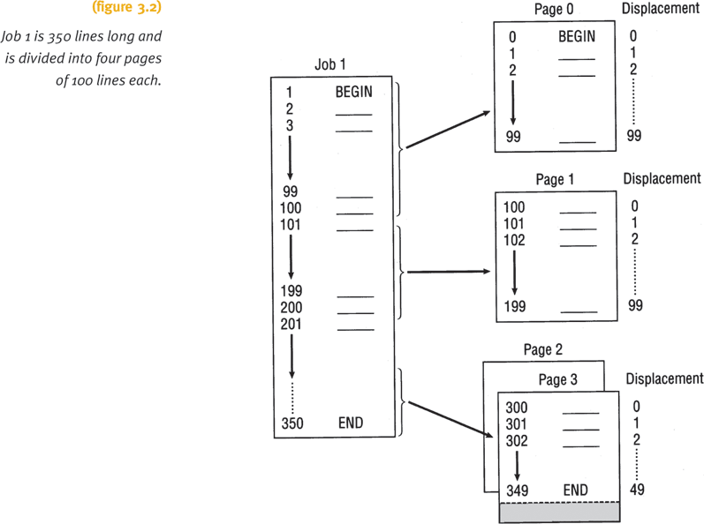
Paged Memory Allocation (continued)

Slide 70
Paged Memory Allocation (continued)
Steps to determining exact location of a line in memory
  Determine page number and displacement of a line
  Refer to the job’s PMT
    Determine page frame containing required page
  Obtain address of the beginning of the page frame
    Multiply page frame number by page frame size
  Add the displacement (calculated in first step) to starting address of the page frame
Address resolution
  Translating job space address into physical address
  Relative address into absolute address

Slide 71
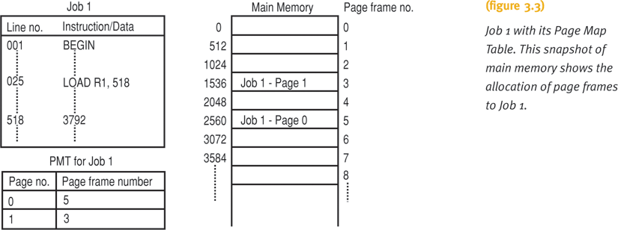
Paged Memory Allocation (continued)

Slide 72
Paged Memory Allocation (continued)
Advantages
  Allows job allocation in noncontiguous memory
    Efficient memory use
Disadvantages
  Increased overhead from address resolution
  Internal fragmentation in last page
  Must store entire job in memory location
Page size selection is crucial
  Too small: generates very long PMTs
  Too large: excessive internal fragmentation

Slide 73
Demand Paging
Pages brought into memory only as needed
  Removes restriction: entire program in memory
  Requires high-speed page access
Exploits programming techniques
  Modules written sequentially
    All pages not necessary needed simultaneously
  Examples
    User-written error handling modules
    Mutually exclusive modules
    Certain program options: mutually exclusive or not accessible
    Tables given fixed amount of space: fraction used
      For example: symbol table in an assembly program.

Slide 74
Demand Paging (continued)
Allowed for wide availability of virtual memory concept
  Provides appearance of almost infinite or nonfinite physical memory
  Jobs run with less main memory than required in paged memory allocation scheme
  Requires high-speed direct access storage device
    Works directly with CPU
  Swapping: how and when pages passed in memory
    Depends on predefined policies

Slide 75
Demand Paging (continued)
Memory Manager requires three tables
  Job Table
  Page Map Table: additional three new fields
    If requested page is already in memory
    If page contents have been modified
    If page has been referenced recently
      Determines which page remains in main memory and which is swapped out
  Memory Map Table

Slide 76
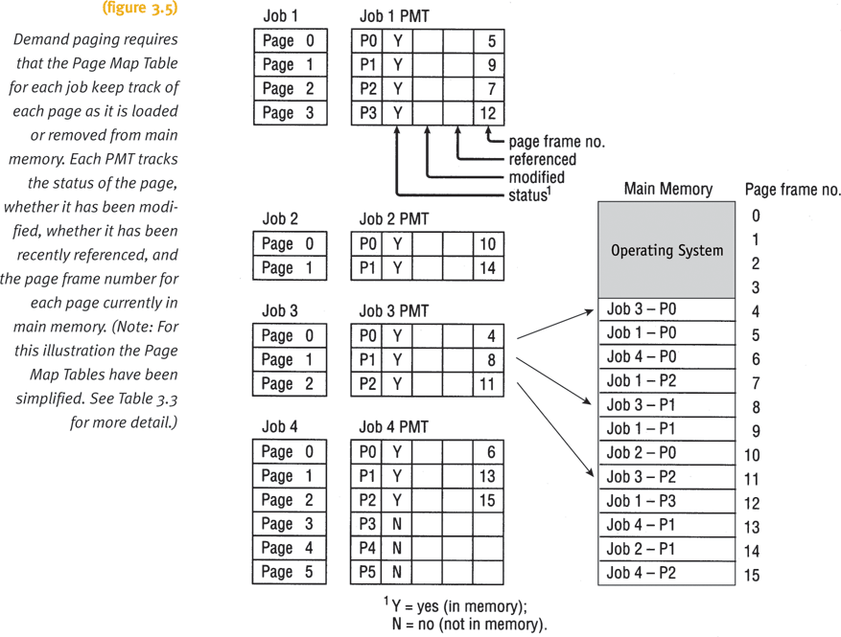
Demand Paging (continued)

Slide 77
Demand Paging (continued)
Swapping Process
  Exchanges resident memory page with secondary storage page
  Involves
    Copying resident page to disk (if it was modified)
    Writing new page into the empty page frame
  Requires close interaction between:
    Hardware components
    Software algorithms
    Policy schemes

Slide 78
Demand Paging (continued)
Hardware instruction processing (p74)
Page fault: failure to find page in memory
Page fault handler (p75)
  Part of operating system
  Determines if empty page frames in memory
    Yes: requested page copied from secondary storage
    No: swapping occurs
  Deciding page frame to swap out if all are busy
    Directly dependent on the predefined policy for page removal

Slide 79
Demand Paging (continued)
Thrashing
  An excessive amount of page swapping between main memory and secondary storage
  Due to main memory page removal that is called back shortly thereafter
  Produces inefficient operation
  Occurs across jobs
    Large number of jobs competing for a relatively few number of free pages
  Occurs within a job
    In loops crossing page boundaries

Slide 80
Demand Paging (continued)
Advantages
  Job no longer constrained by the size of physical memory (concept of virtual memory)
  Utilizes memory more efficiently than previous schemes
  Faster response
Disadvantages
  Increased overhead caused by tables and page interrupts

Slide 81
Page Replacement Policies and Concepts
Policy to select page removal
  Crucial to system efficiency
Page replacement polices
  First-In First-Out (FIFO) policy
    Best page to remove is one in memory longest
  Least Recently Used (LRU) policy
    Best page to remove is least recently accessed
Mechanics of paging concepts
The working set concept

Slide 82
First-In First-Out
Removes the longest page in memory
Efficiency
  Ratio of page faults to page requests
  FIFO example: not so good
    Efficiency is 9/11 or 82%
FIFO anomaly
  More memory frames does not lead to better performance

Slide 83
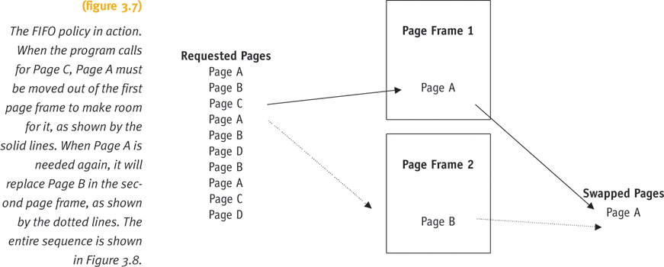
First-In First-Out (continued)

Slide 84
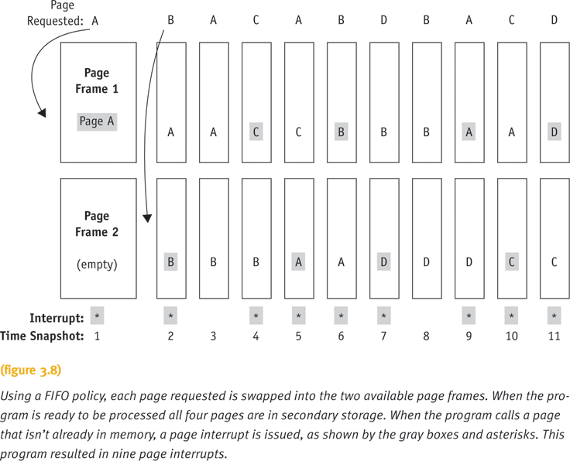
First-In First-Out (continued)

Slide 85
Least Recently Used
Removes the least recently accessed page
Efficiency
  Causes either decrease in or same number of page interrupts (faults)
  Slightly better (compared to FIFO): 8/11 or 73%
LRU is a stack algorithm removal policy
  Increasing main memory will cause either a decrease in or the same number of page interrupts
  Does not experience FIFO anomaly

Slide 86
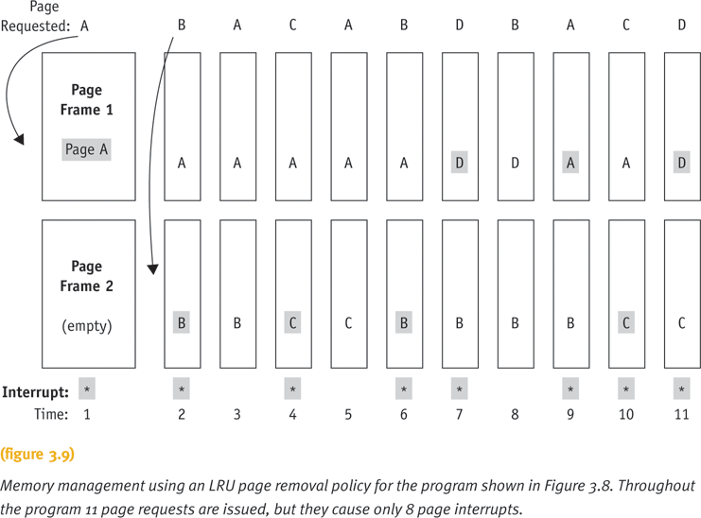
Least Recently Used (continued)

Slide 87
LRU Implementation
Bit-shifting technique (Fig. 3.11, p81)
  Uses 8-bit reference byte and bit-shifting technique
  The reference bit for each page is updated with every CPU clock tick.
  If any page is referenced, its leftmost reference bit will be set to 1.
  When a page fault occurs, the LRU policy selects the page with the smallest value in its reference byte because that would be the least recently used.

Slide 88
Second-Chance Algorithm (p80)
Another page replacement algorithm (Fig. 3.10)
Each page attached with a reference bit and set to 0 initially
Implemented by a circular queue with a reference bit pointer
If a page is replaced, say page 3, then its reference bit will be set to 1
Next time, if the page 3 is checked, its reference bit will be set to 0 and it will not be replaced immediately. This will give page 3 a “second chance” to stay in main memory.
If all page bits are set to 1, then the pointer cycles through the whole queue to reset all reference bits to 0. This means to give each page a second chance. Hence, the next page with reference bit is 1 will be replaced.

Slide 89
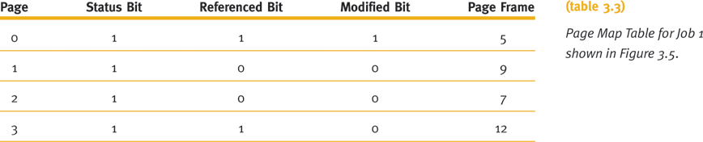
The Mechanics of Paging
Page swapping
  Memory manage requires specific information
  Uses Page Map Table Information
    Status bits of: “0” or “1”

Slide 90
The Mechanics of Paging (continued)
Page map table bit meaning
  Status bit
    Indicates if page currently in memory
  Referenced bit
    Indicates if page referenced recently
    Used by LRU to determine page to swap
  Modified bit
    Indicates if page contents altered
    Used to determine if page must be rewritten to secondary storage when swapped out
Four combinations of modified and referenced bits (00, 01, 10, 11). See Table 3.5.

Slide 91
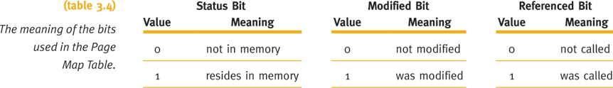
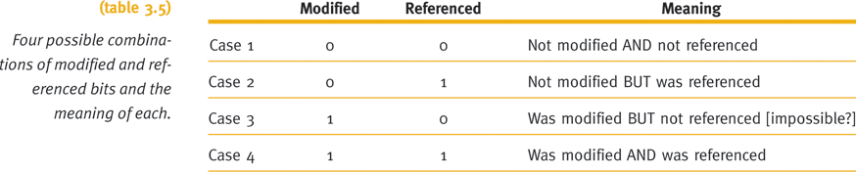
The Mechanics of Paging (continued)

Slide 92
The Working Set
Set of pages residing in memory accessed directly without incurring a page fault
  Improves performance of demand page scheme
Requires concept of “locality of reference”
  Occurs in well-structured programs
    Only small fraction of pages needed during program execution
Time sharing systems considerations
System decides
  Number of pages comprising (consisting of) working set
  Maximum number of pages allowed for a working set

Slide 93
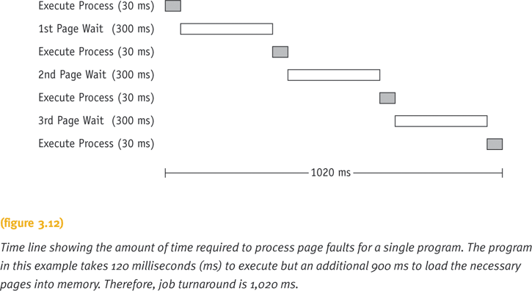
The Working Set (continued)

Slide 94
Segmented Memory Allocation
Each job divided into several segments
  Segments are different sizes
  One for each module containing related functions
Reduces page faults
  Segment’s loops not split over two or more pages
Main memory no longer divided into page frames
  Now allocated dynamically
Program’s structural modules determine segments
  Each segment numbered when compiled/assembled
  Segment Map Table (SMT) generated

Slide 95
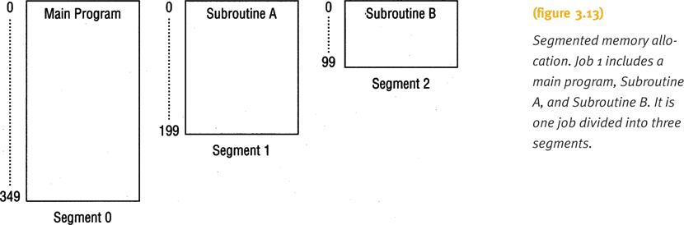
Segmented Memory Allocation
(continued)

Slide 96
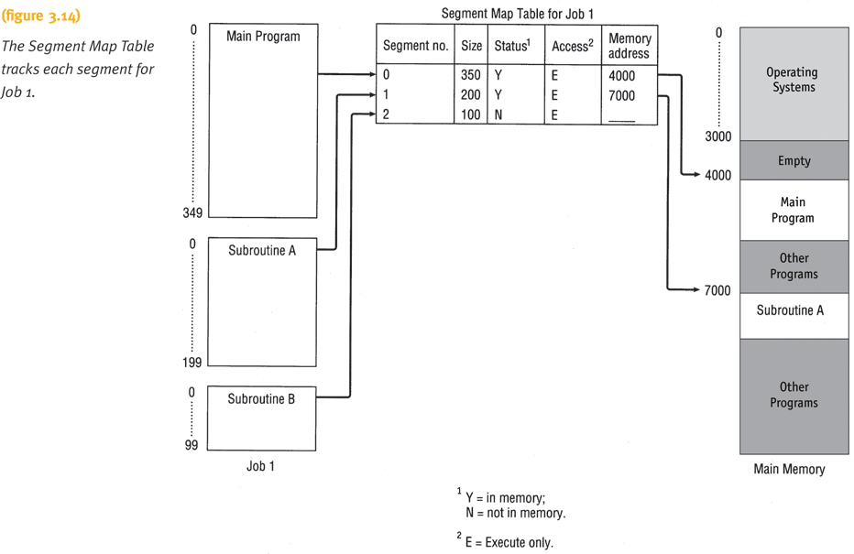
Segmented Memory Allocation
(continued)

Slide 97
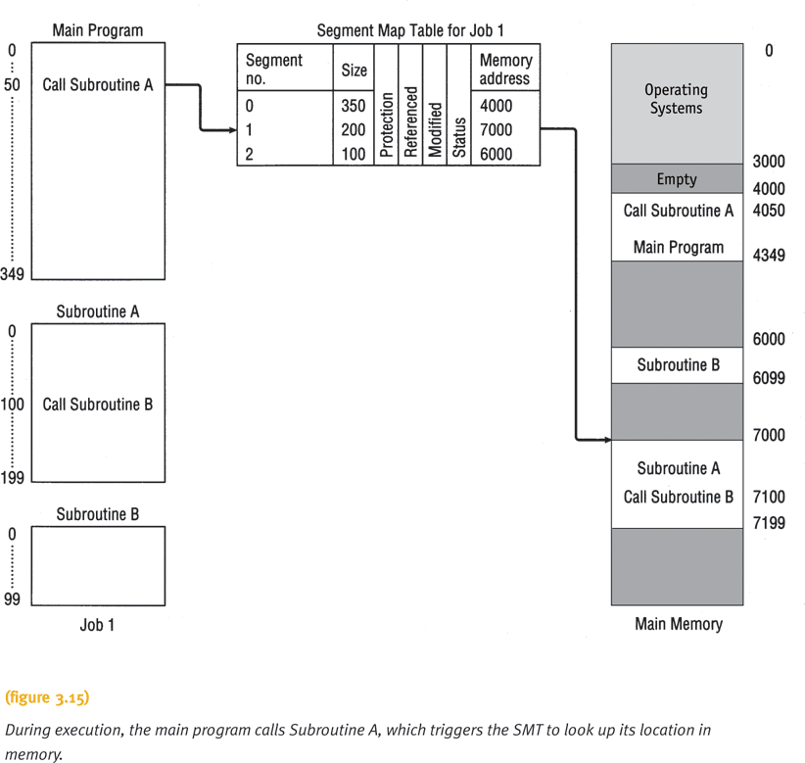
Segmented Memory Allocation
(continued)

Slide 98
Segmented Memory Allocation
(continued)
Memory Manager tracks segments using tables
  Job Table
    Lists every job in process (one for whole system)
  Segment Map Table
    Lists details about each segment (one for each job)
  Memory Map Table
    Monitors allocation of main memory (one for whole system)
Instructions with segments ordered sequentially
Segments not necessarily stored contiguously

Slide 99
Segmented Memory Allocation
(continued)
Addressing scheme requirement
  Segment number and displacement
Advantages
  Internal fragmentation is removed
  Memory allocated dynamically
Disadvantages
  Difficulty managing variable-length segments in secondary storage
  External fragmentation

Slide 100
Segmented/Demand Paged
Memory Allocation
Subdivides segments into pages of equal size
  Smaller than most segments
  More easily manipulated than whole segments
  Logical benefits of segmentation
  Physical benefits of paging
Segmentation problems removed
  Compaction, external fragmentation, secondary storage handling
Addressing scheme requirements
  Segment number, page number within that segment, and displacement within that page

Slide 101
Segmented/Demand Paged
Memory Allocation (continued)
Scheme requires four tables
  Job Table
    Lists every job in process (one for the whole system)
  Segment Map Table
    Lists details about each segment (one for each job)
  Page Map Table
    Lists details about every page (one for each segment)
  Memory Map Table
    Monitors allocation of page frames in main memory (one for the whole system)

Slide 102
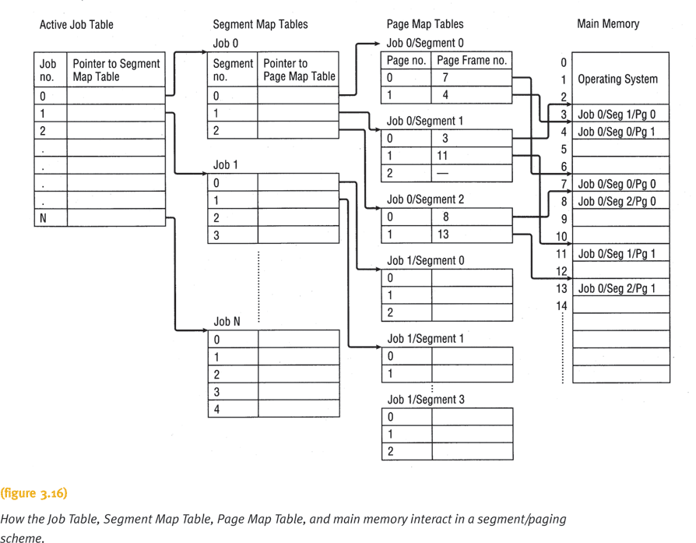
Segmented/Demand Paged
Memory Allocation (continued)

Slide 103
Segmented/Demand Paged
Memory Allocation (continued)
Advantages
  Large virtual memory
  Segment loaded on demand
  Logical benefits of segmentation
  Physical benefits of paging
Disadvantages
  Table handling overhead
  Memory needed for page and segment tables

Slide 104
Associative memory
A special type of computer memory used in certain very high speed searching applications.
It is also known as content-addressable memory (CAM)
Unlike standard computer memory (RAM) in which the user supplies a memory address and the RAM returns the data word stored at that address, a CAM is designed such that the user supplies a data word and the CAM searches its entire memory to see if that data word is stored anywhere in it.
If the data word is found, the CAM returns a list of one or more storage addresses where the word was found
From: http://en.wikipedia.org/wiki/Content-addressable_memory

Slide 105
Associative Memory (continued)
In memory management applications, CAM stores segment map tables (SMP) and page map tables (PMT)
To simultaneous searches contents in SMT and PMT for each active job
Advantage
  Could speed up table searching
Disadvantage
  High cost of complex hardware required to perform parallel searches

Slide 106
Virtual Memory
Allows program execution even if not stored entirely in memory
Requires cooperation between memory manager and processor hardware
Advantages
  Job size not restricted to size of main memory
  Memory used more efficiently
  Allows an unlimited amount of multiprogramming
  Eliminates external fragmentation and minimizes internal fragmentation

Slide 107
Virtual Memory (continued)
Advantages (continued)
  Allows the sharing of code and data
  Facilitates dynamic linking of program segments
Disadvantages
  Increased processor hardware costs
  Increased overhead for handling paging interrupts
  Increased software complexity to prevent thrashing

Slide 108
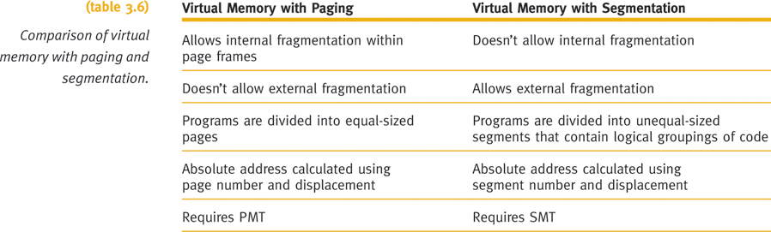
Virtual Memory (continued)

Slide 109
Cache Memory
Small high-speed intermediate memory unit
Performance of computer system increased
  Memory access time significantly reduced
  Faster processor access compared to main memory
  Stores frequently used data and instructions
Two levels of cache
  L1: a pair of cache memory built into CPU; one to store instructions and the other to store data
  L2: Connected to CPU; contains copy of bus data
Data/instructions move from main memory to cache
  Uses methods similar to paging algorithms
  (See page 96 for details)

Slide 110
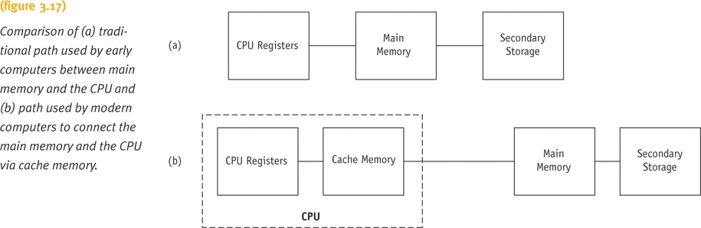
Cache Memory (continued)

Slide 111
Cache Memory (continued)
Four cache memory design factors
  Cache size, block size, block replacement algorithm, and rewrite policy
An optimal selection of cache size and replacement algorithm is necessary
  May lead to 80-90% of all requests in cache
Efficiency measures
  Cache hit ratio (h)
    = # of requests found in cache / total # of requests * 100
  Miss ratio (1-h)
  Average memory access time
    = AvgCacheAccessTime + AvgMemACCTime * (1-h)
    Because CPU always checks cache memory first, if miss, then check main memory.

Slide 112
Address Types
A physical address or absolute address refers to a physical location in main memory.
A logical address is a reference to a memory location “independent of the current assignment of data to memory.” (Stallings)
Compilers produce code in which all memory references are expressed as logical addresses.
A relative address is a kind of logical address in which the address is expressed relative to some known point in the program. Usually, the first location is address zero and all other addresses are offsets from this address.

Slide 113
Address Translation
Programs are loaded in main memory with all memory references in relative form
Physical addresses are calculated “on the fly” as the instructions are executed. This process is called address translation, or address mapping.
For adequate performance, the translation from relative to physical address must by done by hardware.

Slide 114
Hardware Address Translation in Partitioned Memory Systems
When a process is dispatched, a base register (in the CPU) is loaded with the physical start address of the process and a bounds register is loaded with the process’s ending physical address.
When a relative address is encountered, add it to the contents of the base register to get the actual physical address.
The physical address is then compared to the bound register to make sure the process isn’t referencing a location outside its own address space.
The hardware mechanism provides translation and protection.

Slide 115
Address Translation in Paging
In a paged system, mapping is done on a page-by-page basis. In partitioned systems it’s done on a process-by-process basis.
The hardware must be able to extract two pieces of data from the logical address:
  a logical page number
  an offset within the page. (The offset is like a relative address within the page.)

Slide 116
Steps in Address Translation
Extract the logical page number from the logical address.
Use the page to index into the page table and retrieve the frame number where the page is stored.
Concatenate page number and offset to get physical address.

Slide 117
Address Translation
For this to work, the compiler must be able to assign logical addresses that can be used by the hardware to determine page number and offset.
That is, the logical address should be a two-part value, (p,d), where p is the logical page number and d is an offset, or displacement, within the page.

Slide 118
Logical Addresses
This is easily done by requiring the size of a page (and the size of a frame) to be a power of two.
Now, the relative address (defined relative to the origin of the program) and the logical address (p,d) will be the same.
To try to understand this, consider an analogy to decimal numbering.

Slide 119
Address Translation
Base 10 Example
Suppose a computer uses decimal (power of 10) addressing instead of binary. Let page & frame size be 100, with addresses in the range 0000-9999.
  Frame 0 has start address 0000; frame 1 has start address 0100 and so on.
  Logical address 7324 can easily be divided into two parts: page number =73, offset=24.
  If logical page 73 is loaded into frame 1, logical address 7324 maps into physical address 0124.

Slide 120
CAUTION
The previous example was just an analogy – there are no computers with power-of-ten addressing systems.

Slide 121
Address Translation
The decimal example works because the logical address can be easily divided into page-number and displacement fields, since each digit represents a power of 10.
Binary addresses can also be divided into page-number and displacement fields, where each digit represents a power of 2.

Slide 122
Logical Address Example
Assume an addressing scheme that uses 16-bit addresses and has a page size of 1K (1024 = 2¹⁰).
  We’ll need 10 bits for the displacement.
  Now there are 6 bits left for the page number, so our hypothetical computer has 2⁶ = 64 pages.
  A process 2700 bytes long will occupy three pages, with fragmentation of 372 bytes in the last page.

Slide 123
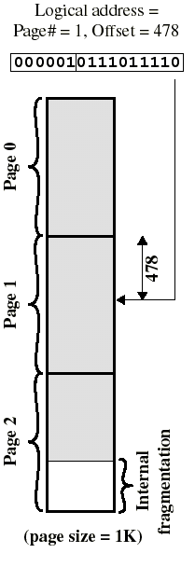
Example
Consider relative address 1502. It is located on logical page 1, at offset 478. (p, d) = 1,478.
The binary representation of 1502 is 0000010111011110.
Divide this into a six-bit page number field: 000001 = 1
and a 10-bit displacement field: 0111011110 = 478.
When the MM hardware is presented with a binary address it can easily get the two fields.

Slide 124
Generalized Address Translation
Page size is determined by the hardware. It is typically no smaller than 512 bytes and may be as large as 8K.
In general, an n + m bit address represents an n-bit page number field and an m-bit offset (displacement) field.
The MMU (Memory Management Unit) of the hardware can be designed to implement address translation automatically.

Slide 125
Generalized Address Translation
  Extract the leftmost n bits of the relative address to get the page number, p.
  Use the page number as an index into the page table and get the frame number, k, which has start address k x 2^{m}. (rightmost m bits are zero)
  The physical address is now k x 2^{m} + d. The physical address can be obtained directly by concatenating the frame number and the offset - no need to multiply and add.

Slide 126
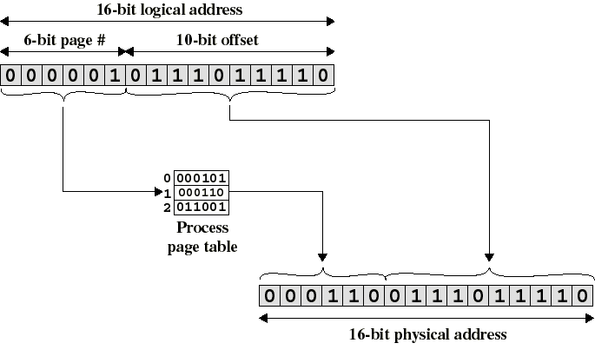
Paged Address Translation
(Notice that only the
page# field changes)

Slide 127
Page Table Register (PTR)
How does the MMU know where to find the page table for a given process?
Most architectures have a special register for this purpose. When a process is dispatched (put into the Run state), the start address of its page table is loaded into the PTR as part of the process switch.

Slide 128
Simple Segmentation
Segmentation also divides the process address space into chunks, now called segments.
Segments are based on logical, not physical, characteristics of the program. One segment might contain the main program, others a group of related functions, etc.
Each segment can be a different size.

Slide 129
Address Translation in Segmentation
Similar to simple paging - for example, there is a segment table, which specifies
  start address of each segment
  segment length
The hardware uses the segment number as an index into the segment table.
Segment start address + displacement = physical address.

Slide 130
Address Translation Remarks
(mostly about paging)
Address translation is transparent to the user.
The OS is responsible for finding enough free frames for a process and for creating and initializing the page table.
Protection is provided by the page table. If the referenced page isn’t part of the process address space, the PT entry will be null.

Slide 131
Memory Allocation in Paging
Paging dramatically simplifies allocation.
The frame table is structure that many operating systems use to support allocation.
The frame table has an entry for each frame in memory. The entry tells whether the corresponding frame is empty or allocated, and if allocated, to which process.

Slide 132
Summary
Paged memory allocation
  Efficient use of memory
  Allocate jobs in noncontiguous memory locations
  Problems
    Increased overhead
    Internal fragmentation
Demand paging scheme
  Eliminates physical memory size constraint
  LRU provides slightly better efficiency (compared to FIFO)
Segmented memory allocation scheme
  Solves internal fragmentation problem

Slide 133
Summary (continued)
Segmented/demand paged memory
  Problems solved
    Compaction, external fragmentation, secondary storage handling
Associative memory
  Used to speed up the process
Virtual memory
  Programs execute if not stored entirely in memory
  Job’s size no longer restricted to main memory size
Cache memory
  CPU can execute instruction faster

Slide 134
